Slide 1
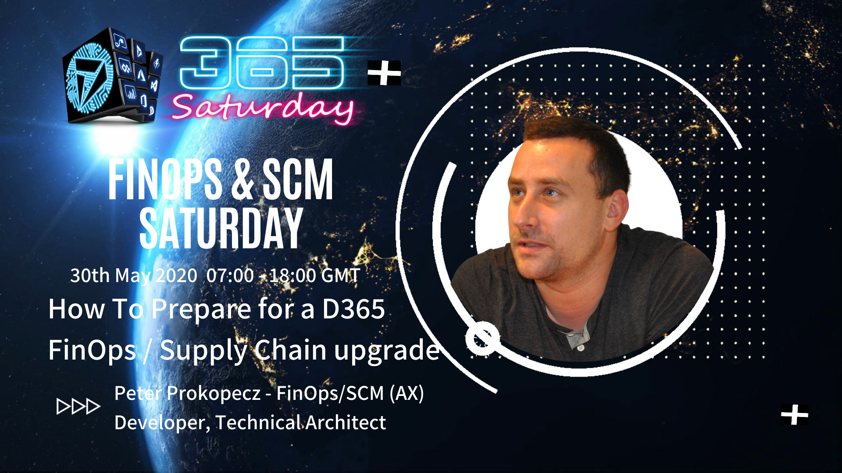

Slide 2

How to prepare for a D365FO/SCM upgrade
Peter Prokopecz

Slide 3
Speaker Introduction
Peter Prokopecz
AX technical lead @ JJ Food Service Ltd. (Food wholesale)
Owner @ DAXVision ERP Consulting Ltd. (Your external AX tech. team)
http://www.daxvisionerp.com/
info@daxvisionerp.com
Studies: IT engineer BSc (2006) + MBA (2019)
AX experience: AX from 2003 – Trade and logistics, Developer, Technical architect
Lived in: Budapest (Hungary), Dubai (UAE), Cambridge (UK), Gent (Belgium)

Slide 4
Agenda
Why do we upgrade
Functional upgrade
Technical upgrade
Data upgrade and cleanup
LCS demo, AX environment demo (model)

Slide 5
INTRODUCTION

Slide 6

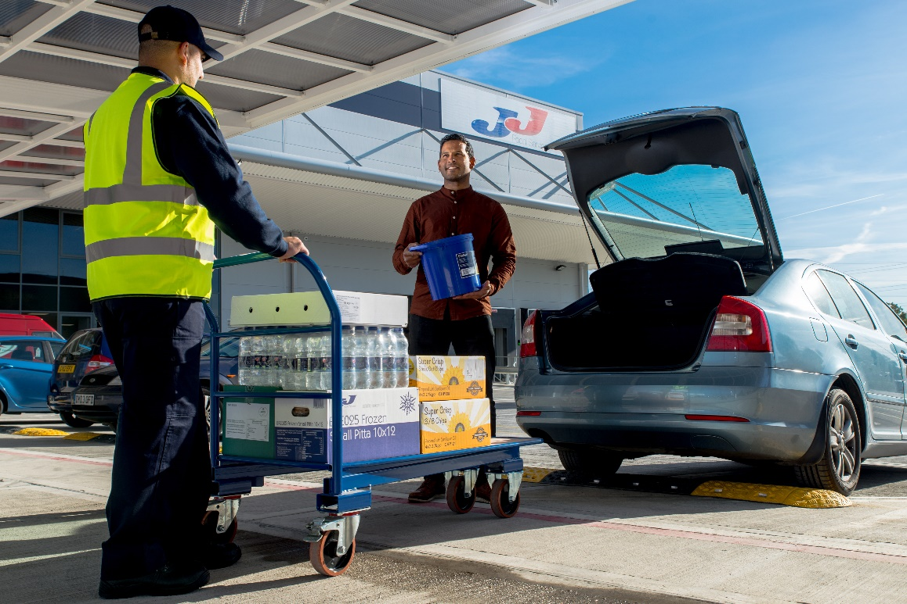
UK Food and drink wholesaler.
We have been around for more than 30 years.
Orders can be placed online via the JJ website or App for collection or delivery.
Next day delivery, same day collection, same day delivery in some areas.
10+ years of history, using Microsoft Dynamics AX from version 3.0 to 2012 R3
B2B originaly, delivering to the general public also
11 UK branches
60.000 customers
100+ delivery vehicles

Slide 7

JJ website and App
You can place an order in just seconds using the JJ Foodservice website or App and we will let you know when your order is just minutes away. https://www.jjfoodservice.com/

Slide 8
Why do we upgrade?
Standardization
Utilize advantages of cloud technology (PowerApps, PowerAutomate, LogicApps, PowerBI, Azure DevOps, Application Insights, etc.)
Cost and complexity of maintaining redundant, failsafe system
licensing
replacing HW every 5 years
Lots of work for IT staff
Code and data cleanup
End of product support

Slide 9
Why do we upgrade – new functionality (1)
https://docs.microsoft.com/en-us/dynamics365/fin-ops-core/fin-ops/get-started/whats-new-changed
New web browser-based client
Visual Studio is the only developer environment
BI reports embedded to AX client (browser)
Task recorder available to all users
Form templates are forced
MRP is separate service in the cloud
Vendor portal
Business events lets you extend the product and give triggers to external applications

Slide 10
Why do we upgrade – new functionality (2)
Cloud POS provides a web app POS
set up prices and discounts based on the sales channel
Standard e-commerce site and mobile app to support these sales channels.
Monitoring and alerting system in standard without the need to install and set up any software.
Cloud operations to replicate your production environment
Easier updates of the ERP (One version, Evergreen, Extensibility)
Production and Sandbox/testing env. are managed by Microsoft
Power users can add new fields to tables and forms, modify reports and share it in the system without development and code release
Batch processing improvements (inactive period+daylight saving, aborting, copy batch task, relative priority, reserved, dependency)

Slide 11
Why do we upgrade – new functionality (3)
export up to 1 million rows to Excel, assynchronous, alerted when ready to download
SQL index defragmentation batch job to maintain database table indexes in order to keep the system perform well. (Ola Hallengren)
Manage access to network printers across legal entities from one convenient dashboard.
Synchronize data to Azure Data Lake to use for different Azure services, BI reporting and integration.
Automatically send e-mails to internal and external contacts when a data that the user can see has changed. This functionality was requested by users on the ideas site.
Year-end closing for multiple legal entities from one page.

Slide 12
Why do we upgrade – new functionality (4)
Personalized product recommendations for customers based on their category and purchase history and much more using cognitive analysis and machine learning.
Consignment inventory
Handle pallets with mixed items (Advanced warehousing from AX2012 R2)
Acceptance test library can be automated so after Microsoft delivers new functionality and fixes, we can automatically test if our functions still behave as expected. We can imitate entering data and validate the result in a test environment.

Slide 13
UPGRADE OVERVIEW

Slide 14
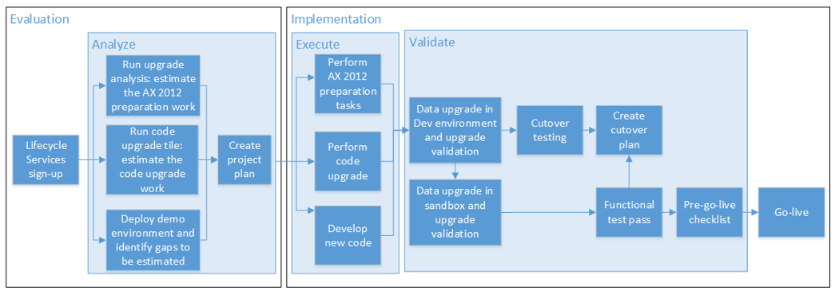
Overview of the procedure
For more details
https://docs.microsoft.com/en-us/dynamics365/unified-operations/dev-itpro/migration-upgrade/upgrade-overview-2012

Slide 15
Overview – AX 2012 to D365 Upgrade
Analyze
Execute
Validate
Estimate and analyze upgrade tasks
Fit/Gap analysis
Create project plan
AX 2012 database preparation
Code upgrade
Data upgrade
Upgrade validation
Functional test pass
Cutover testing
Notes:
TODO – introduce methodology

Slide 16
Upgrade tasks from another point of view?
Functional upgrade
Standardization, simplification
Implement new functionality
Technical upgrade
Get rid of unused code and objects
Identifying empty Tables
Data upgrade and cleanup
Archive and purge
Unused Table indexes
Data replication in Azure

Slide 17
FUNCTIONAL UPGRADE

Slide 18
Functional upgrade
Standardization
Replacing custom solutions with standard AX features (Call Center, Credit Card)
Considering to implement Retail as eCommerce backend
Catch-weight items
Cleanup
Disable/remove unused functionality
Redesign
WMS2 -> WHS (Advanced warehousing)
AIF document services -> Data management and data entities
Splitting up complex forms and business logic (Order pad)

Slide 19
Standardization
Vendor collaboration (previously known as the Vendor portal)
Personalized product recommendations
Batch active periods
Batch job to handle SQL index defragmentation
Custom Order pad and task history to move to the e-commerce portal

Slide 20
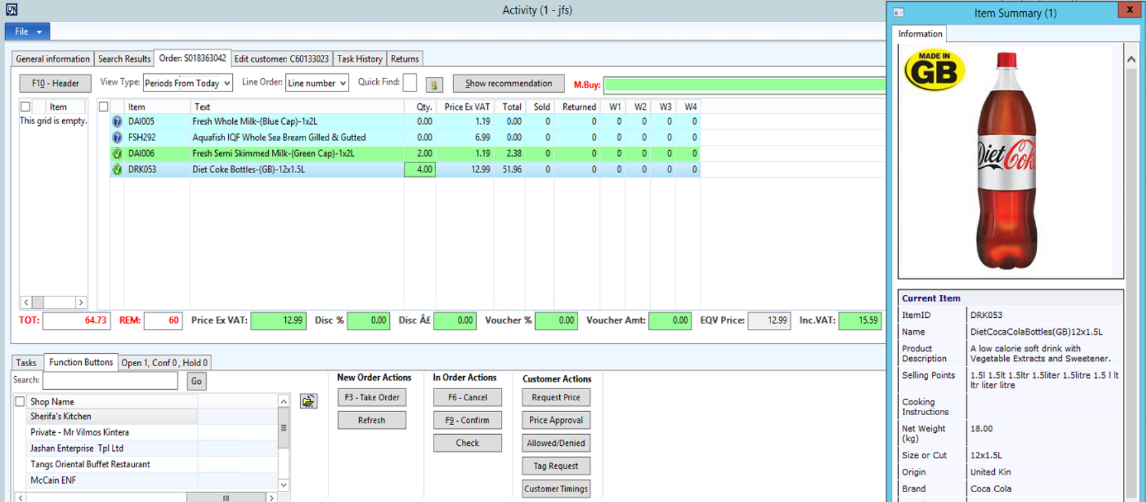
Order pad - Complex for browser

Slide 21
Redesign example
Warehouse Zones and areas
WMS2 deprecated
Implement Advanced warehousing

Slide 22
TECHNICAL UPGRADE

Slide 23
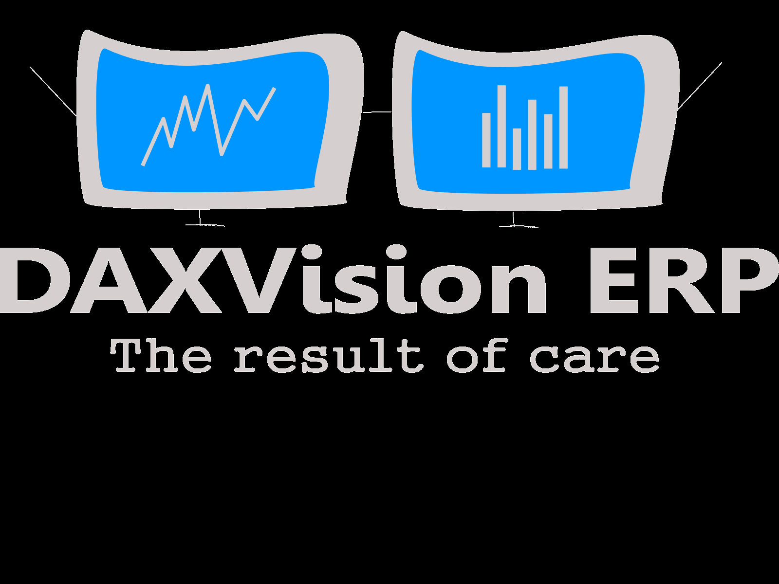
LCS Demó

Slide 24
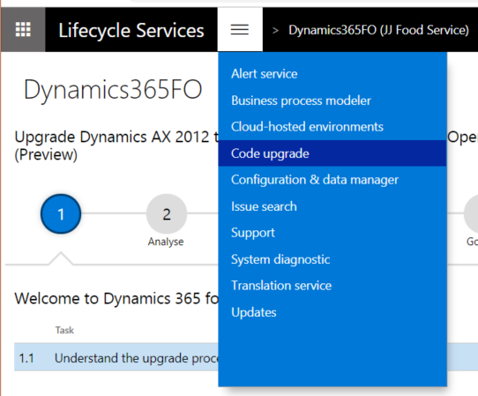
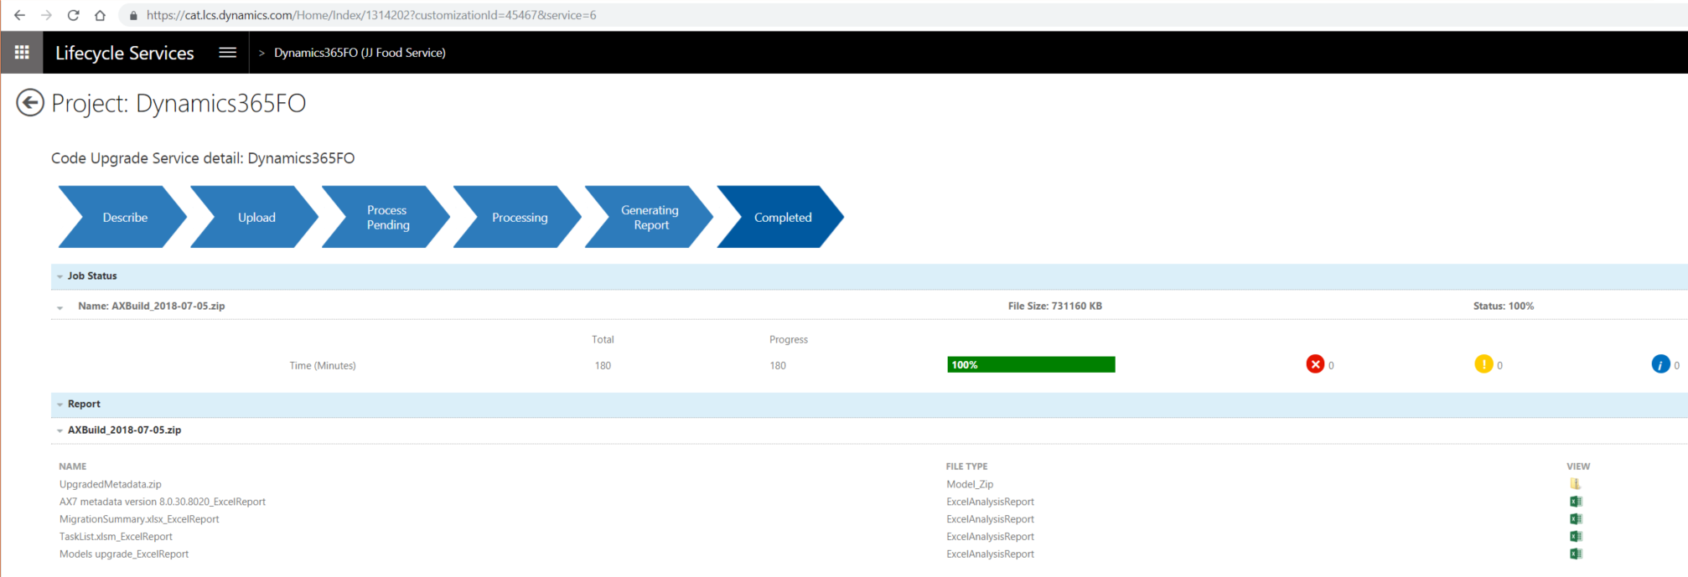
Code upgrade

Slide 25
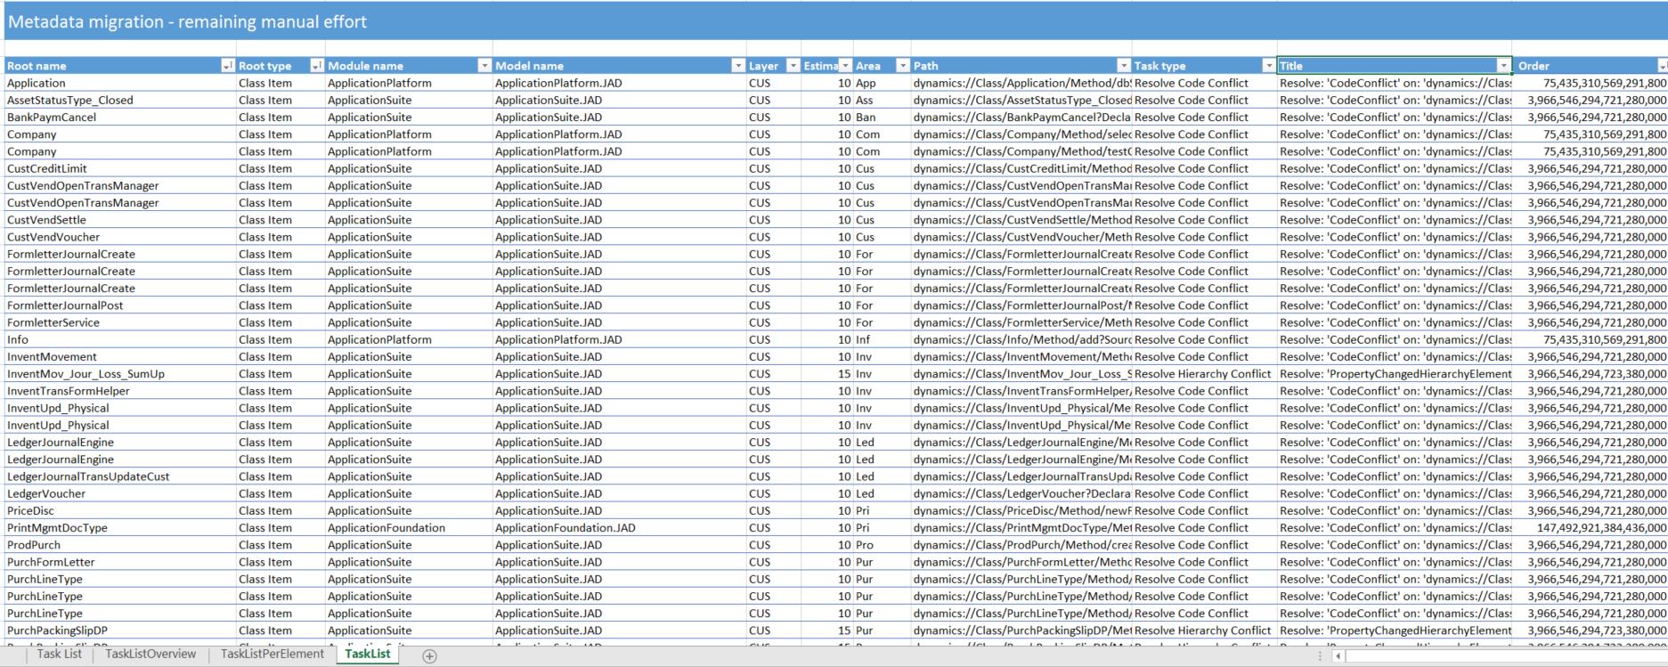
Task list

Slide 26
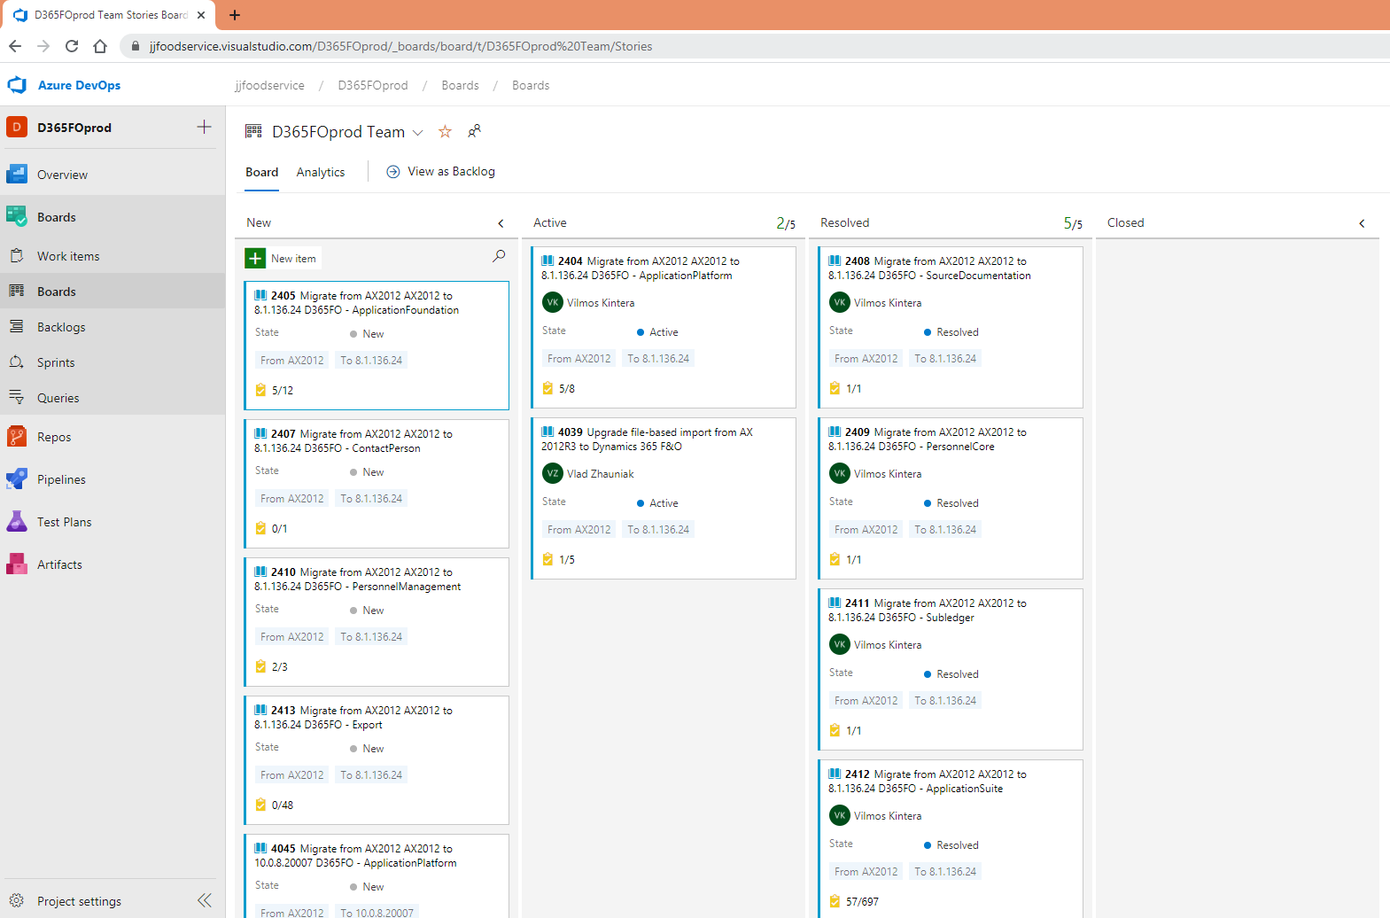
Azure DevOps Boards – Work items

Slide 27
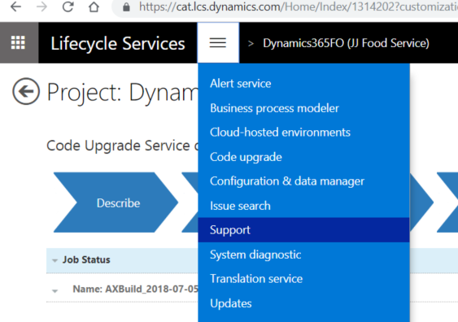
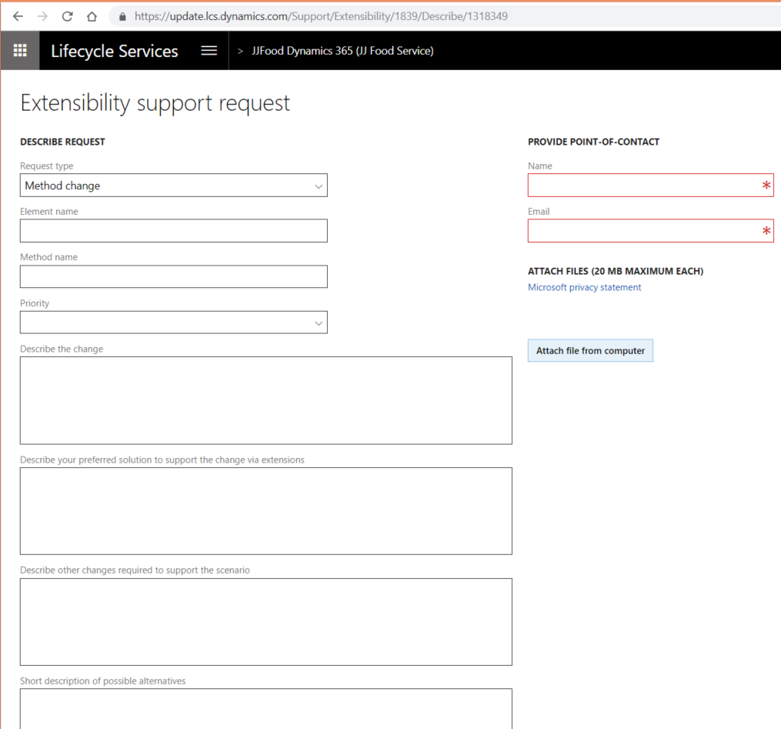
Extensibility support request

Slide 28
Technical upgrade preparation in AX2012
Code cleanup
Identifying unused objects via X++, MorphX and T-SQL
Get rid of compilation warnings and best practice violations
LCS Code Analysis for finding typically incorrect implementations
Consolidate prefixes and suffixes (JJE, CCM, JAD)
Code upgrade
Change overlayered code to utilize pre/post event handlers
Modify forms to use templates

Slide 29
X++ and T-SQL tricks
Empty table cleanup
Find unused objects – X++ based on Xref (http://daxvisionerp.com/blog/)
T-SQL ISVplus layer table without index usage (http://daxvisionerp.com/blog/)
SysIndexStat mostRecentUse (http://daxvisionerp.com/blog/)

Slide 30
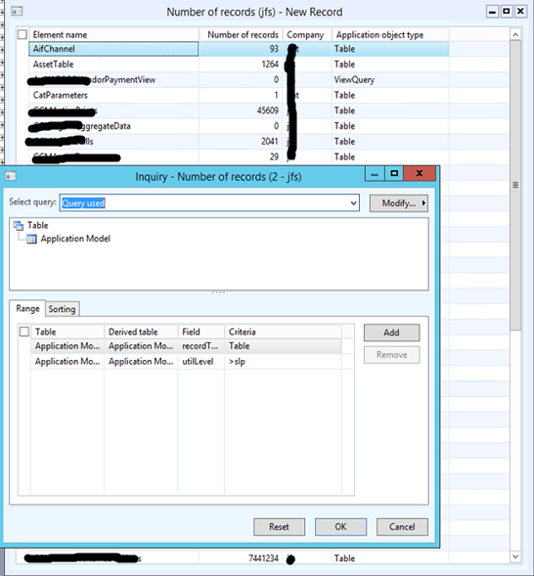
Empty table cleanup
AX Dev client: Tools/Number of records
Add advanced filter: ‘utilLevel>slp’
Consider temp tables
Useful to compare with result of db_index_usage_stats (coming slide)

Slide 31
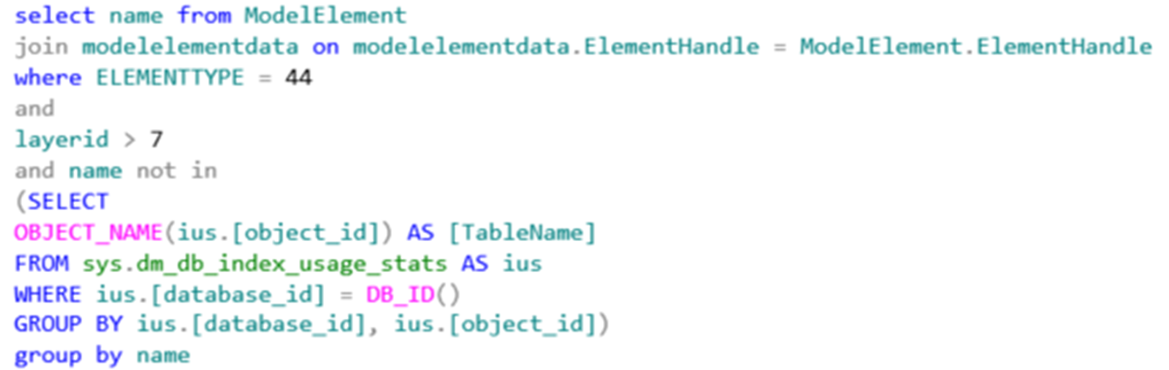
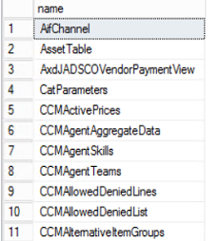
Find unused objects – TSQL 1
No index usage registered for these non-standard tables after last SQL restart

Slide 32
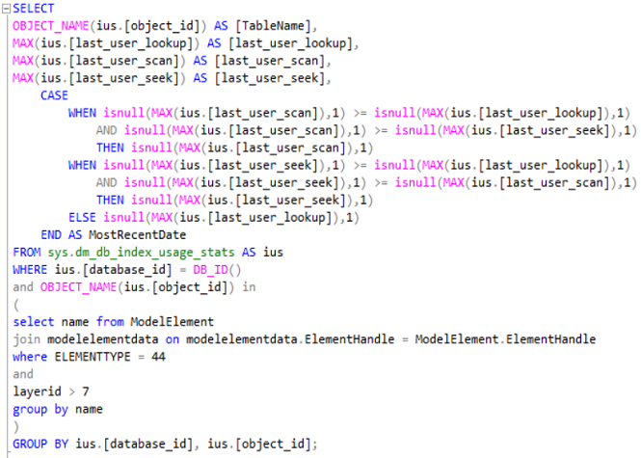
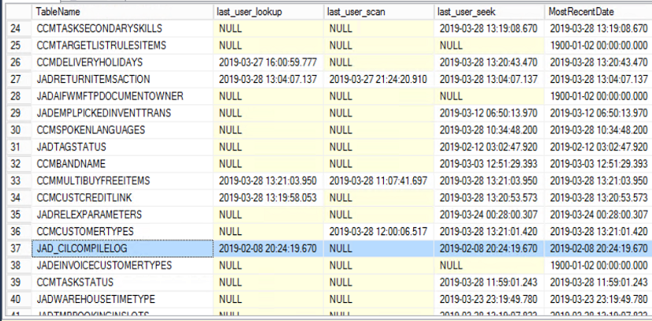
Find unused objects – TSQL 2
Most recent use of indexes
Queried db_index_usage_stats, added an extra field: „MostRecentUse” which is showing the most recent from last_user_lookup, last_user_scan and last_user_seek fields

Slide 33
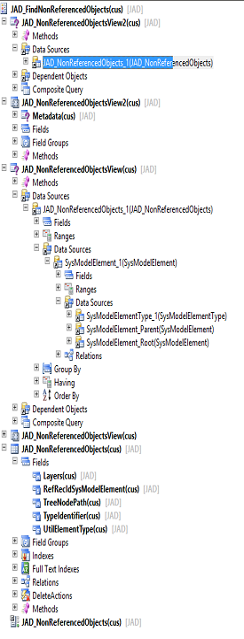
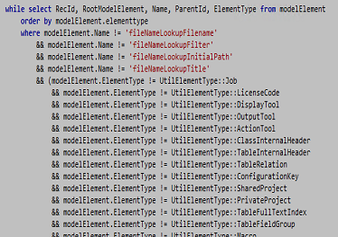
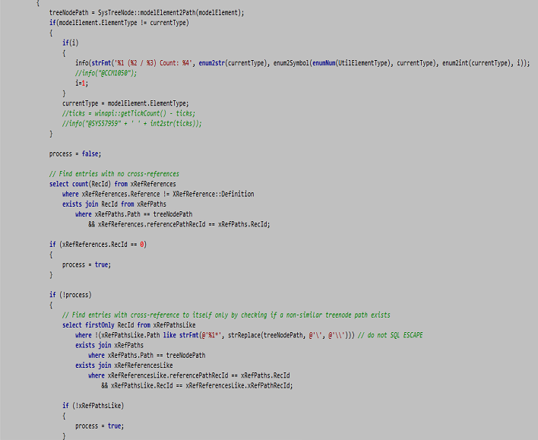
Find unused objects – XRef (1)

Slide 34
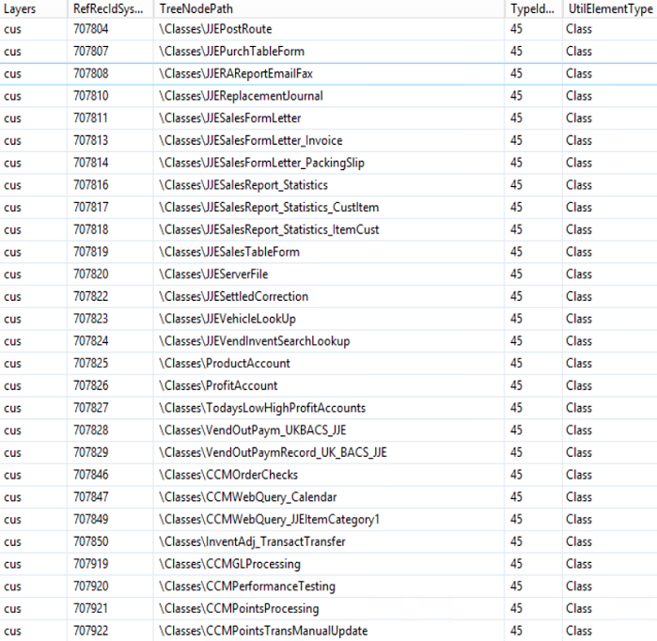
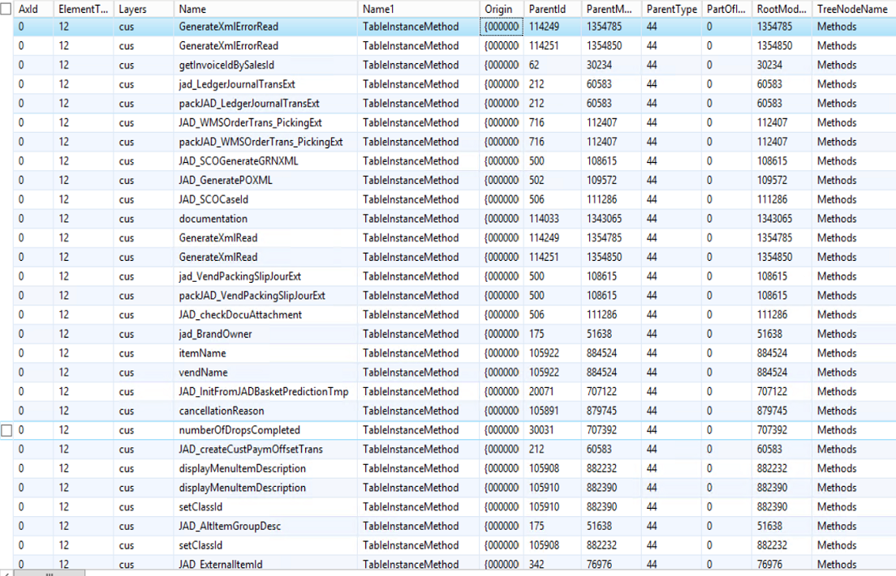
Find unused objects – XRef (2)

Slide 35
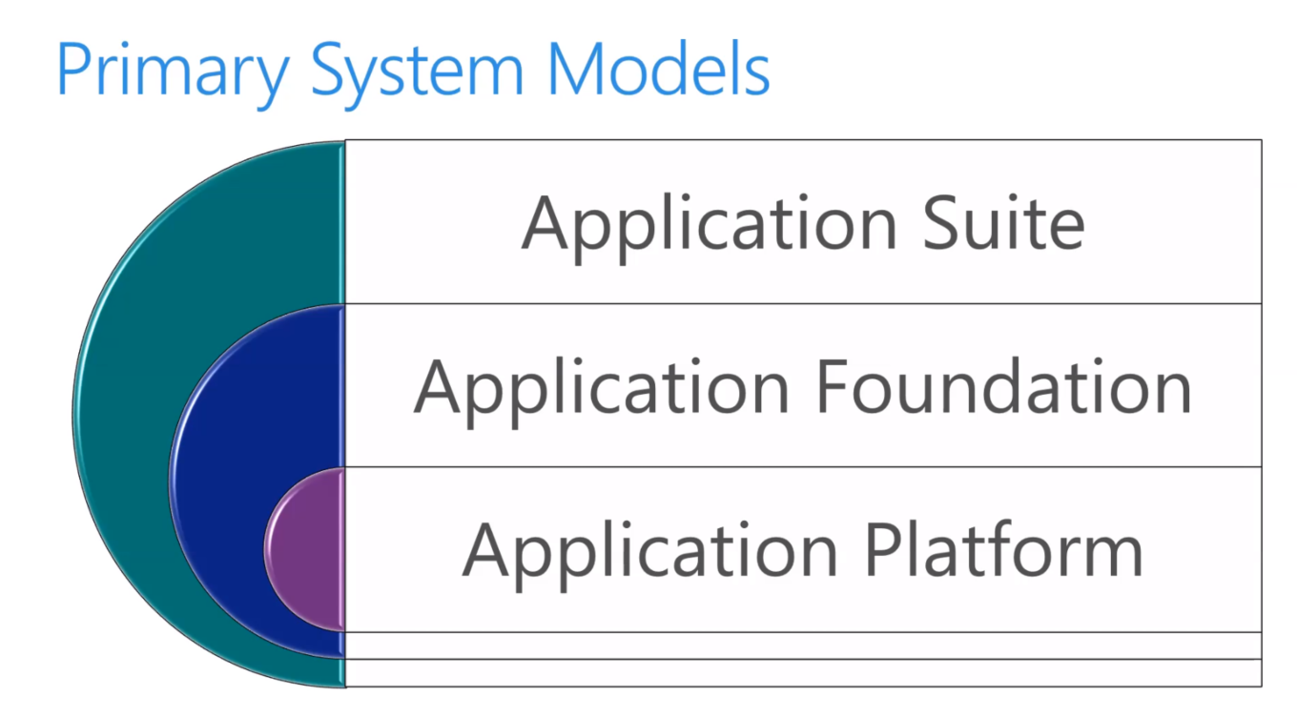
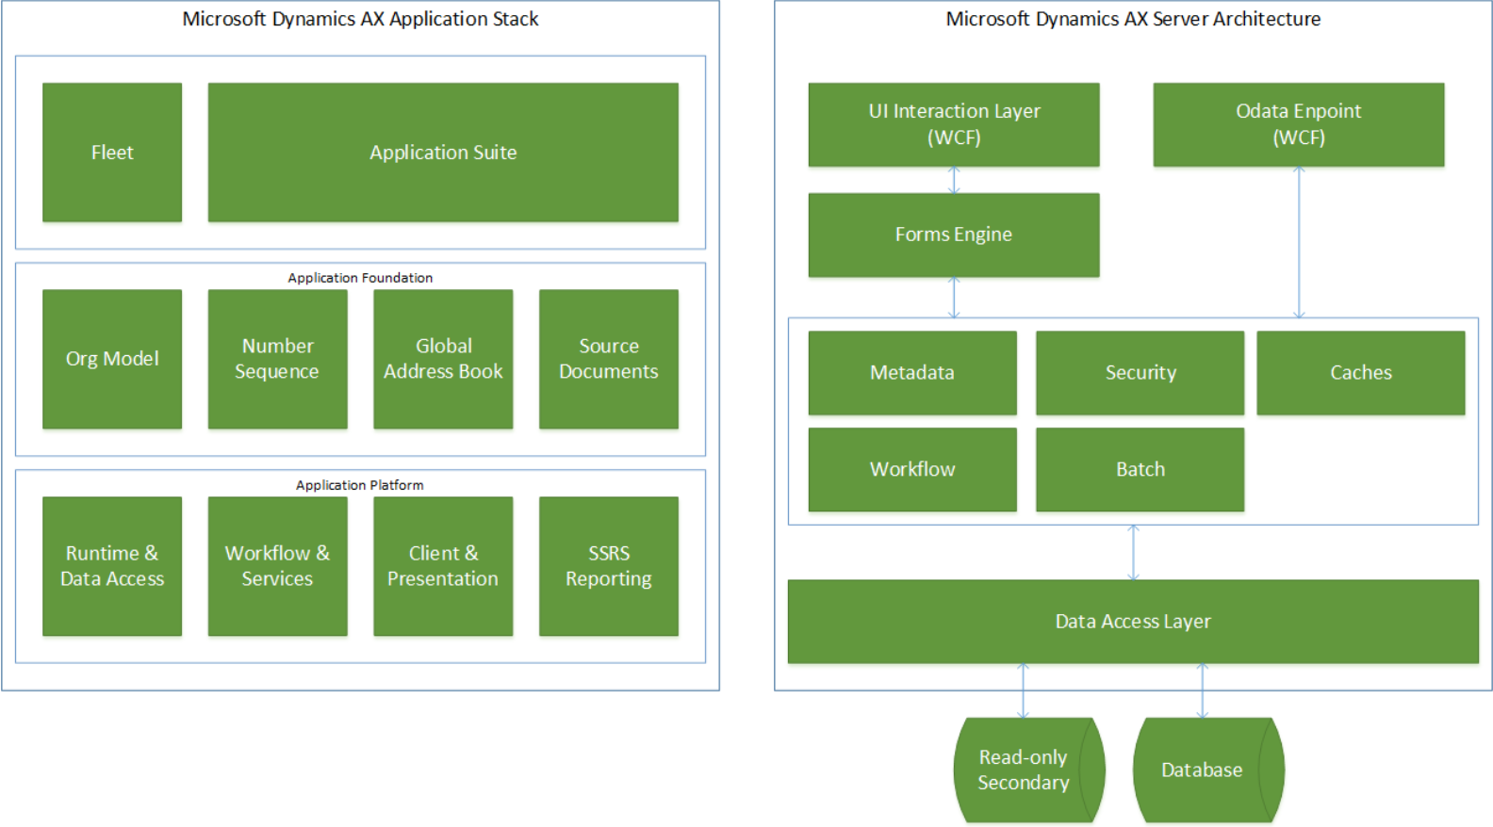
Microsoft package structure
How did Microsoft design their packages for sys layer objects?

Slide 36
How should I plan packages and models?
Do not overcomplicate –> circular references
Core – Changes for low level code (Sys*, RunBase) and frameworks (Batch*, FormLetter*, Appl/Info)
Operation – Business logic. Could split it further per larger areas
Integration – Apps, eCommerce
Reporting – SSRS and PowerBI

Slide 37
Naming conventions
Examples:
\Tables\JAD_MyCustomTable (JAD Operation)
\Tables\PurchTable.JADOperationExtension
\Classes\PurchTable_Table_JADOperation_Extension
\Classes\PurchTableType_Class_JADOperation_Extension
\DataEntities\JAD_ReceiptNote_Entity

Slide 38
Demo – Package Models, DevEnv

Slide 39
DATA UPGRADE

Slide 40
Data upgrade intro
Collation!
Purge and archive!
Empty table cleanup
Find unused objects – X++ based on Xref (http://daxvisionerp.com/blog/)
T-SQL ISVplus layer table without index usage (http://daxvisionerp.com/blog/)
SysIndexStat mostRecentUse (http://daxvisionerp.com/blog/)

Slide 41
Docs.microsoft.com
https://docs.microsoft.com/en-us/dynamics365/unified-operations/dev-itpro/migration-upgrade/prepare-migration

Slide 42
Caution! Collation!
The only supported collation is SQL_Latin1_General_CP1_CI_AS Microsoft Docs
Your DB needs to be converted most probably.
1. Exporting to BACPAC (an Azure backup format)
SqlPackage.exe /a:export /ssn:localhost /sdn:<database to export> /tf:D:\Exportedbacpac\my.bacpac /p:CommandTimeout=1200 /p:VerifyFullTextDocumentTypesSupported=false
2. SQL Server replication to the cloud

Slide 43
Data upgrade és cleanup
Purge and archive data
Standard clean up jobs in AX: batch history, AIF log
IDMF 2012
Archive application
Replicate data to cloud before golive - prod data is synched up to cloud in regular fashion - during test cycles instead of taking a backup from prod, take the replicated data so you are testing and go through the upgrade process so what you will actually do

Slide 44
FINISHING

Slide 45
What have I talked about
Why do we upgrade
Functional upgrade
Technical upgrade
Data upgrade and cleanup
LCS demo, AX environment demo (package-model)

Slide 46
Thank you
Peter Prokopecz
info@daxvisionerp.com
DAXVision ERP Consulting Ltd.
http://www.daxvisionerp.com/
https://www.linkedin.com/in/peter-prokopecz/

